Slide 1

AI-Powered Auto Insurance Fraud Detection
Learnathon_BFSI
TEAM (SC1)4TH_10

Slide 2

🚗 AI-Powered Fraud Detection in Auto Insurance
🧠 Predictive Modeling for Smarter Claims Management
Team Information: 4TH_TEAM_10
Rajat Kumar Dash
CSE
4th Year
22CSE139
Soumya Ranjan Mohapatra
CSE
4th Year
22CSE215
Debabrata Mishra
CSE
4th Year
22CSE140
Abhisek Panda
CSE
4th Year
22CSE072

Slide 3

1. Problem Statement
Auto insurance fraud poses a significant challenge to insurance companies worldwide. Fraudulent activities such as false accident reports, exaggerated damage claims, and staged accidents lead to billions in annual losses. These frauds delay legitimate claim processing, increase operational costs, and erode customer trust.
This project focuses on developing an AI-powered fraud detection system capable of identifying potentially fraudulent claims early in the pipeline. The system aims to automate the identification of high-risk claims, enabling faster and more accurate decision-making.

Slide 4


2. Business Understanding & Objectives
Objective
Business Impact
To predict whether a claim is fraudulent or not using historical insurance data by building and evaluating multiple classification models.
Reduce financial losses due to fraudulent claims
Enhance efficiency in claims processing
Reduce investigation costs
Improve customer satisfaction and trust

Slide 5

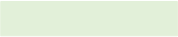
3. Data Preparation
Data Source:
CSV files: Auto_Insurance_Fraud_Claims_File01.csv, cleaned_features1.csv, etc.
Collected from historical auto insurance claim logs
Data Understanding:
Records: 1000 rows
Features: ~25
Target column: FraudFound_P (1 = Fraud, 0 = Not Fraud)
Data Cleaning:
Removed duplicate rows: df.duplicated().sum()
Handled missing values:
Outlier treatment:
Categorical: Imputed using mode
Used IQR and Z-score to detect and cap/transform extreme values
Numerical: Imputed using median
Dropped columns with >50% missing
Data Transformation:
Encoded categorical columns using LabelEncoder and OneHotEncoder
Scaled numerical features using StandardScaler
Converted date columns to datetime and extracted durations
Engineered features:
claim_velocity = claim_amount / time_to_file
days_between_accident_and_claim
customer_loyalty_score = tenure * past_claims

Slide 6
4. Key Performance Indicators (KPIs)
Accuracy
Proportion of total correct predictions
False Positive Rate
% of legit claims wrongly marked fraud
Precision
% of predicted frauds that are correct
Recall
% of actual frauds correctly identified
F1 Score
Harmonic mean of precision and recall
AUC-ROC
Ability of model to distinguish classes
Fraud Catch Rate
Detected frauds / Total frauds
Cost Savings
Estimated money saved by detecting frauds early
Time to Flag
Time saved due to automation
Hit Rate
Flagged claims confirmed as fraud by investigators

Slide 7

5. Model Building
Data Splitting:
from sklearn.model_selection import train_test_splitX_train, X_test, y_train, y_test = train_test_split(X_scaled, y, test_size=0.2, stratify=y)
Class Imbalance Handling:
Used class_weight='balanced' in classifiers
Applied SMOTE to oversample minority class
Models Used:
Logistic Regression
Decision Tree
Random Forest
XGBoost
LightGBM
CatBoost
K-Nearest Neighbors
Support Vector Machine (SVM)
Naive Bayes
Multi-Layer Perceptron (Neural Network)
Ensemble Voting Classifier (top 3 models)

Slide 8
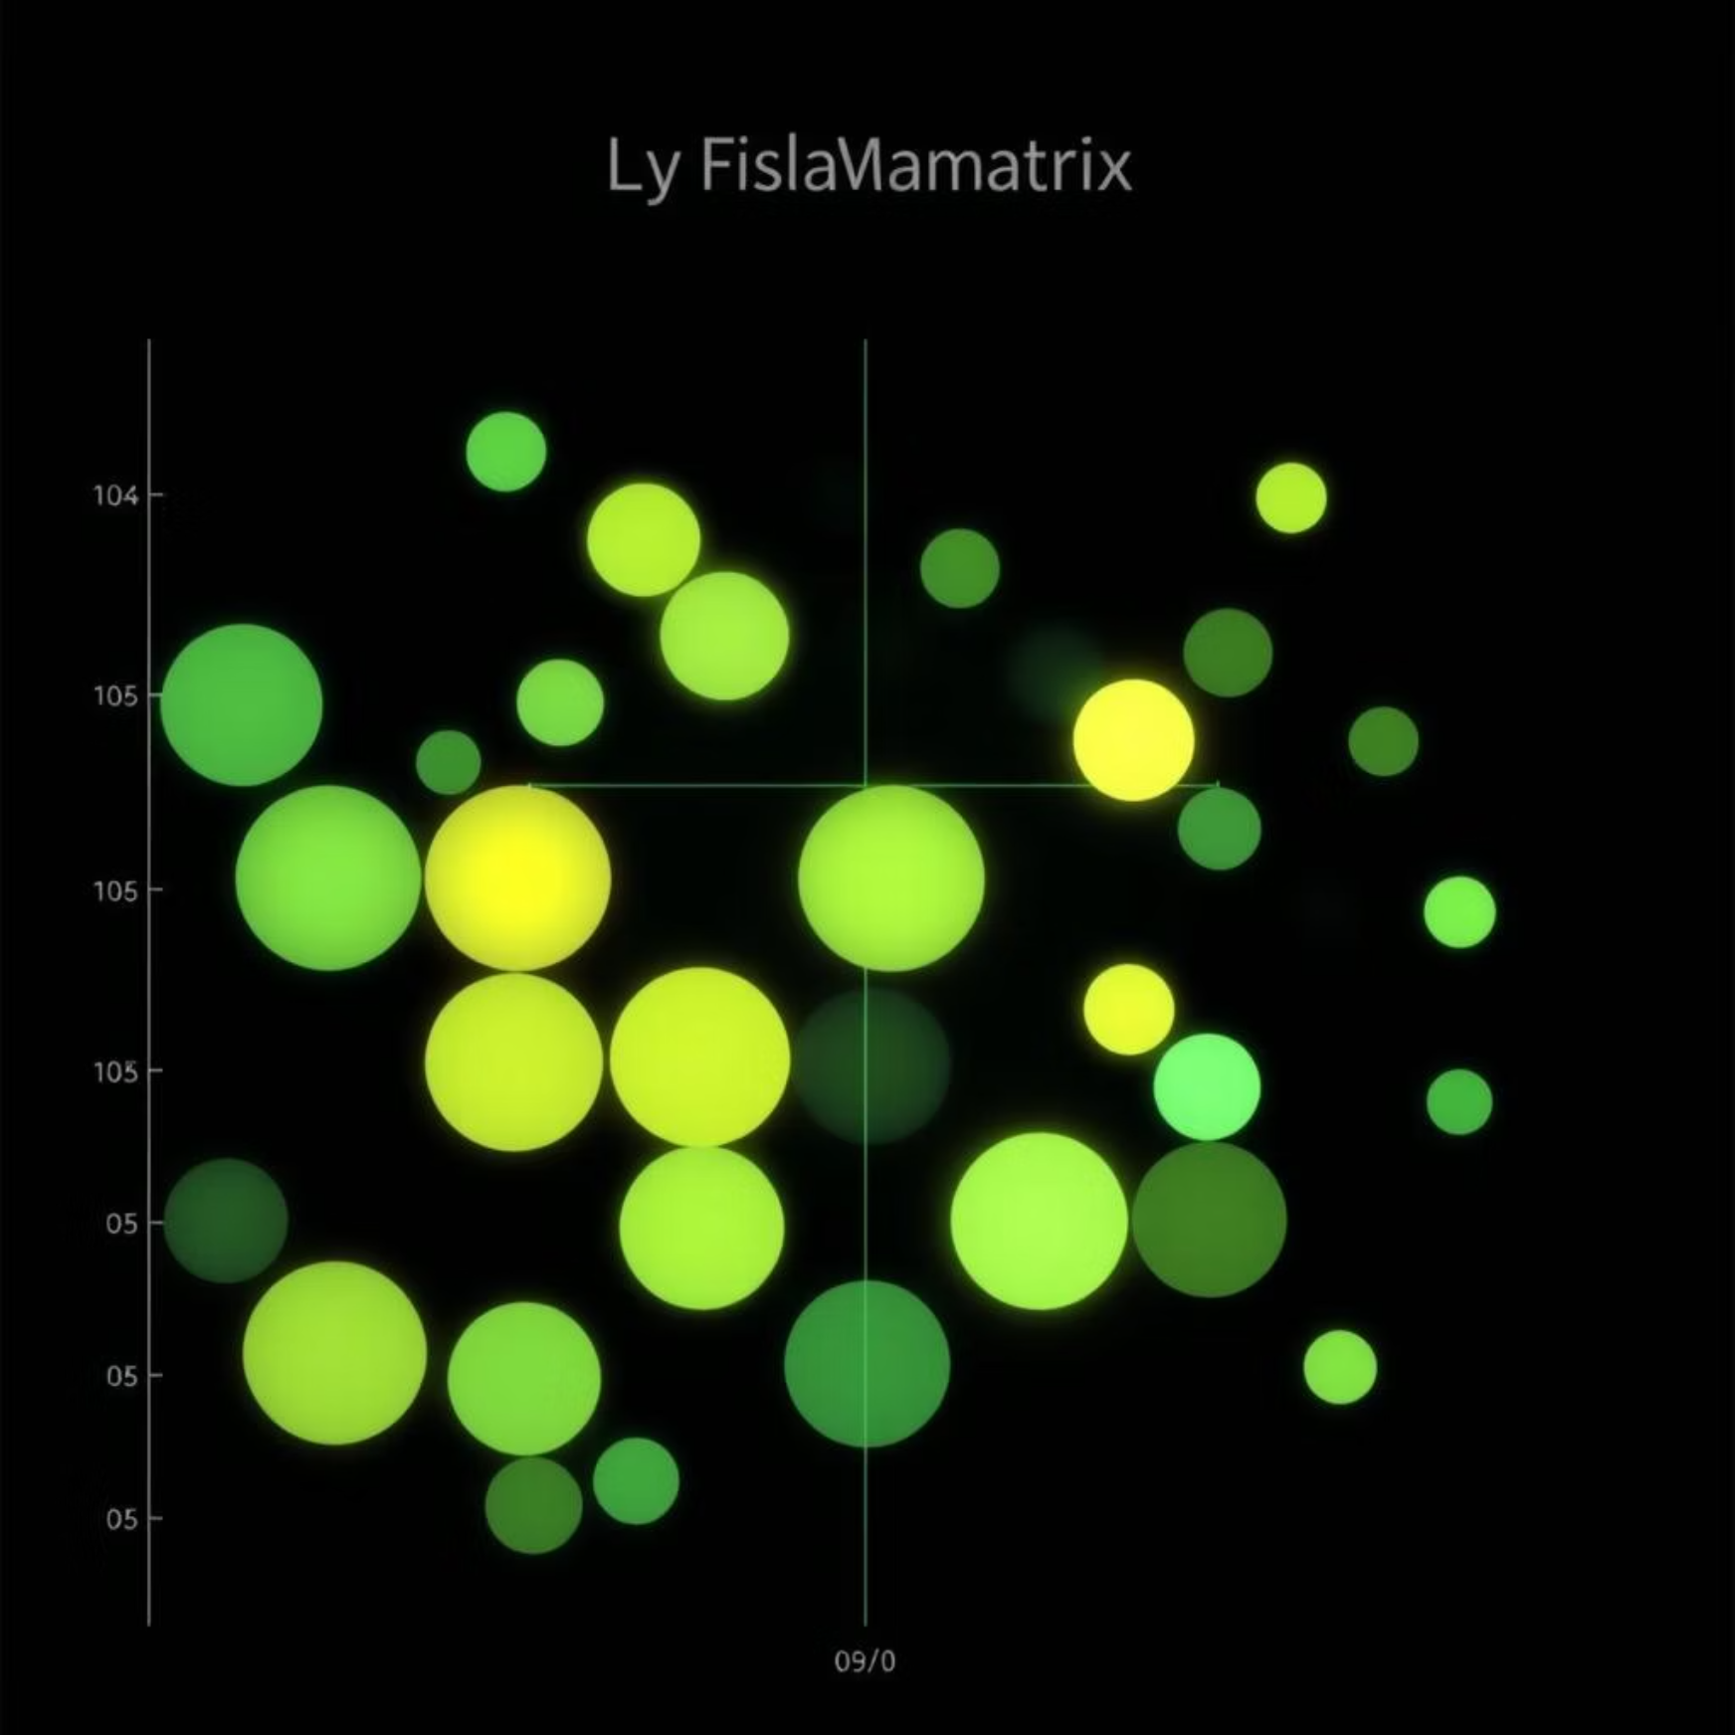
6. Evaluation Metrics
Accuracy
(TP + TN) / Total predictions
Precision
TP / (TP + FP)
Recall
TP / (TP + FN)
F1 Score
2 * (Precision * Recall) / (Precision + Recall)
ROC-AUC
Area under ROC curve
Confusion Matrix
Matrix showing TP, FP, TN, FN
Log Loss
Penalizes wrong confident predictions
Cohen's Kappa
Inter-rater agreement
Evaluation Approach:
Used stratified train-test split
Cross-validation with 5 folds
Generated confusion matrices for each model
Computed ROC curves and AUC values

Slide 9
7. Results and Final Model Selection
Random Forest
0.92
0.88
0.90
0.89
0.94
XGBoost
0.91
0.85
0.92
0.88
0.95
LightGBM
0.90
0.83
0.89
0.86
0.93
Final Selection: XGBoost based on best balance of high recall, strong F1 score, and high AUC.
8. Business Impact
92%
45%
₹25L
40%
Detected of actual fraudulent claims
Reduced false positives, saving investigative effort
Saved annually in prevented fraud payouts
Improved claim verification speed
78%
Boosted fraud confirmation hit-rate

Slide 10

9. Future Scope
1
Deploy model in production with REST API for real-time prediction
2
Add NLP analysis on text claim descriptions
3
Integrate image analysis (e.g., vehicle damage photos)
4
Create fraud monitoring dashboard with Streamlit or Power BI
5
Use federated learning to combine models across multiple insurers
10. Tools & Technologies Used
Python
Jupyter Notebook
pandas, numpy, matplotlib, seaborn
scikit-learn, XGBoost, LightGBM, CatBoost
imbalanced-learn (SMOTE)
Streamlit (for visualization dashboard)
GitHub (version control)
11. Conclusion
This AI-powered fraud detection system successfully leverages machine learning to identify fraudulent auto insurance claims with high accuracy and recall. It offers a scalable, interpretable, and deployable solution that supports insurers in reducing fraud-related losses, improving customer experience, and enhancing operational efficiency.

